Slide 1

Phase 2 Project Housing Regression Analysis
Presented by: Carla Kirby
Notes:
Welcome to the Phase 2 Housing Regression Analysis, my name is Carla Kirby and I will be presenting this data to you today.

Slide 2


Overview
In this linear regression modelling project, we take a deeper dive into housing data for King County a region of Seattle Washington, in the United States. The business owners are eager to understand what favourably drives home purchasing in the King County area.
Notes:
Read verbatim

Slide 3




Agenda Discussion Points
Using an OSEMN analysis model (Obtain, Scrub, Explore, Model, Interpret)
Business Problem
Data
Process Methods
Results
Conclusion
Notes:
We will be addressing the following agenda discussion points: – Discover connections associated to buying a home in Seattle. King County Real Estate is trying to solve to help them with an effective marketing campaign

Slide 4

Business Problem
King County Real Estate would like to build an effective strategy to start up a new real estate business in the well known and established community of king county.
The stakeholders need to understand what drives purchases of homes in this area so they can cater to the community and ensure that they market effectively for their new business.
Notes:
Read verbatim

Slide 5



Data - Obtain & Scrub
.CSV kc_housing_data – sourced from the business owner
Removed null values, duplicates, unnecessary columns, excessive outliers, changed the data types
Wrangled exponential data by creating lambda functions
Inspected data for strong correlations to price, created samples & tested those samples
Obtained necessary statistical values for analysis

Slide 6
Process Methods - Explore
Predicted Correlations
Mean Standard Error - MSE
Kernal Density Estimate - KDE
Plotted and graphically represented Outliers for further analysis
Explored K-folds and cross validation tests
Types of graphical interpretations used to Model: Bell Curve, box plot, multi-scatter plots, histograms

Slide 7
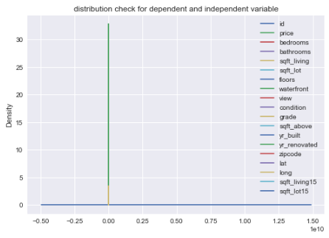
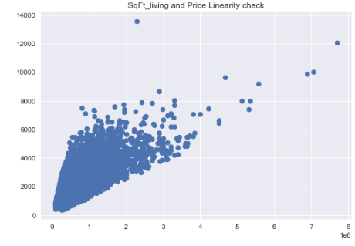
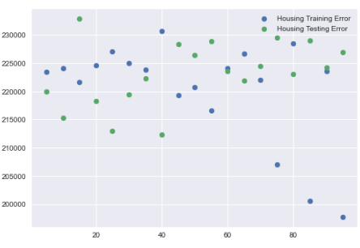
Graphical Data Interpretation - Modelling
Kernal Density Plot
Linearity Check
Training / Testing Error Variances
Strongest Linearity shown was with the sqft_living at 70%– despite the strength of the sqft_lot correlation of 89%
Plot of the residuals appears to be fitted between both data sets with a level of homoscedasticity present.
Non-parametric way to estimate the probability density function of a random variable
Determine that the sqft_living and grade are closest to the expected value 0.00

Slide 8
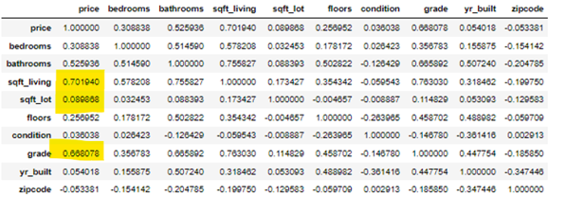
Strongest Linearity shown was with the sqft_living at 70%– despite the strength of the sqft_lot correlation of 89%
Notes:
Read verbatim

Slide 9
Results
Based on the data set and through rigorous testing measures we have determined that ft² of the living area has the strongest linear correlation to increased sales of housing price.

Slide 10


Conclusion – Interpretation
R squared values were between 0 and 1 for both the sqft_lot and the sqft_living – indicating strong correlation to increased sale prices.
Null hypothesis was validated, confirmed that sqft_living has a strong connection to the prices. Elevated size of sqft-Living meant higher cost of the home
Sqft_living presented with the best line of fit when compared to grade and sqft_lot, irrespective of the fact that sqft_lot had a higher correlation value.

